Slide 1
Natural Language Processing
University of Karachi
By: Kumail Abbas

Slide 2
My Intro
Profession:
Software Company: Virtual Solutionz (for 17 years, since age of sixteen)
Academics:
B.E (Electronics) – NED University of Engineering & Technology
MS (Computer Science) – IBA (Gold Medalist)
PhD (Ongoing) – University of Karachi
Others:
Interest in Metaphysical and Mind Sciences
Reiki Master (Spiritual Healing Technique)
Hypnosis Practitioner on personal level

Slide 3
Benefits of this course
Advancements in Natural Language Processing Technology
Information Extraction and Analysis in multiple domains
Career Opportunities in AI and Data Science
How many of you already doing (a) job? (b) freelancing? (c) business?

Slide 4
Freelancing FAQs
How to get first project?
Is it worth taking risk now?
Can I do it along with full-time job?
How much investment is needed?

Slide 5
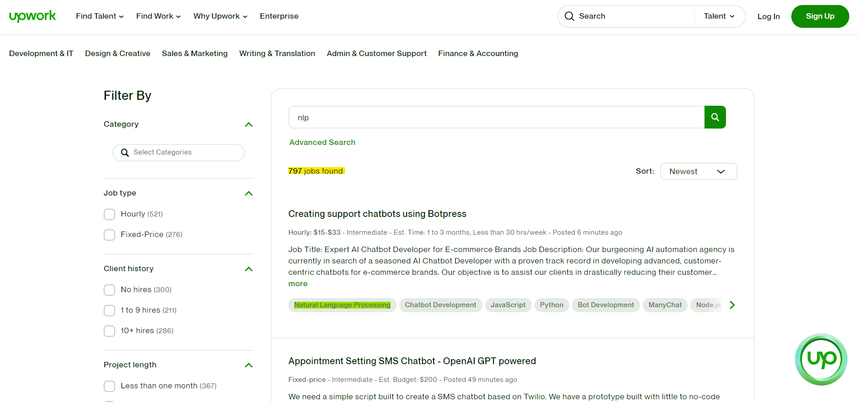

Slide 6
Reference books
Speech and language processing - Danial Jufrasky
Practical Natural language processing - Sowmya Vajjala at el.
Reference video for this lecture:
https://www.youtube.com/watch?v=fOvTtapxa9c

Slide 7
What is NLP
Allow computers to perform tasks that involves human languages
Enabling human to human communication
Improving human to human communication
Simply doing useful processing of text
In NLP, We study algorithms & techniques that is used to process human language
In essence, these algorithms exploit rules and patterns that exist in human languages

Slide 8
Why NLP is important
Huge amount of machine readable data available as natural language in newspaper, web pages, social media etc.
Conversational agents are utilised in massive scale (human-computer interaction)
Human-human interaction is now mediated by computers via social media

Slide 9
Major applications of NLP
Text Analytics
Question answering
Machine Translation

Slide 10
Environment Setup
Install Anaconda from: https://www.anaconda.com/
Working Jupyter Notebook

Slide 11
Text analytics
What is Data mining?
Process of discovering pattern, relationship and valuable information from large and complex datasets
Primary goal of data mining is to identify hidden patterns and trends that help businesses in making informed decision.
Common methods: Clustering, Classification, Regression analysis
Text Analytics
Data mining on text data

Slide 12
Why Text Analytics
Product marketing information
Political opinion tracking
Social Network analysis

Slide 13
Social Network Analysis
Social Network means Graph Data structure.
In social network, nodes represents entities and edges represents relationship between those entities.
Social Network Analysis is about finding out the hidden patterns and relationships in social networks.

Slide 14
A Social Network Analysis Application
Data credits: https://www.covid19india.org/
Reference paper: “Tracking the spread of COVID-19 in India via social networks in the early phase of the pandemic”
The author used NLP techniques to extracted data of interest, in this case countries, cities and states.
Using social network analysis, author figured out most vulnerable from Covid-19 Indian states and cities.

Slide 15
Knowledge in speech and language
Processing any language requires knowledge of the language
For example: you need knowledge of language to count number of words
To process complex tasks: you require deep understanding of the task
To process a human language, you need knowledge of how different words sound like, called phonetics and phonology
People also contract and skip different sound of letter: for example can’t, gotcha. Producing and understanding it requires knowledge of morphology
You won’t be able to understand the language, if words are not spoken in correct sequence. Syntax should be correct
To understand meaning of the spoken sentence, we need to understand meaning of each word, and composition of words - Lexical Sementics

Slide 16
Continue…
Person 1: Hal, open the door.
Robot: No.
It sounds too rude!
Person 1: Hal, open the door.
Robot: I am afraid I can’t open it.
Knowledge of Dialogue is also important

Slide 17
Continue…
How many states were in the United States in that year?
To answer a question like this, you need to examine the previous questions.
In previous, there could be some knowledge about “that year”.
This task is called coreference resolution
Knowledge of discourse is important to process the language

Slide 18
Ambiguity
Languages are ambiguous
I made her duck
Duck can have different meaning here. So meaning is ambiguous.
Each level of language understanding constituent has ambiguity.
Phonetics, lexical semantics etc.
It can mean: "I caused her to lower her head or body quickly" (as a verb "duck")
Or
"I created a duck for her" (as a noun "duck").

Slide 19
Tour of Python
Explore basic construct of a programming language

Slide 20
Python
Common data structures i.e List, Dictionary
If-else statement
For loop and its variation in python
Function definition
Most common NLP libraries
NLTK, Spacy
Libraries must to have for any ML tasks
Numpy, Matplotlib, Pandas, Scikit-Learn

Slide 21
Demo
Python code

